Slide 1
LAB - 02

Slide 2
Task - 1
Write a program that will demonstrate the variable declaration and initialization. Also add proper comments for declaration and initialization starting points.

Slide 3
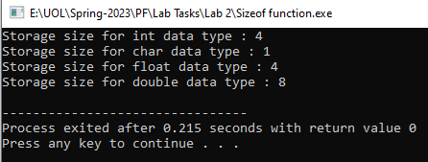
Task - 2
Write a C++ program illustrates the use of sizeof() function which is used to find the memory space allocated for each C++ data type.

Slide 4
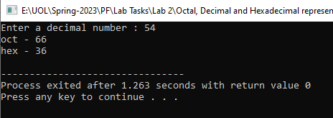
Task - 3
Write a C++ program that will get a decimal number from user and display it to Octal and Hexadecimal representation.

Slide 5
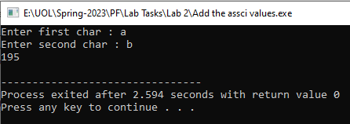
Task - 4
Write a C++ program that will add the ASCII value of two characters and display the sum.

Slide 6
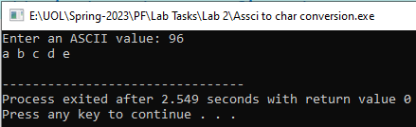
Task - 5
Write a program that takes any ASCII value from user and display next five char after that ASCII value.
Hints: - if user enters 95, your program should display the char against the ASSCII values of 96,97,98,99 and 100.

Slide 7
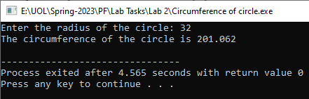
Task - 6
Write a C++ program to compute circumference of a circle.
Hint:
Circumference = 2 * PI * radius;

Slide 8
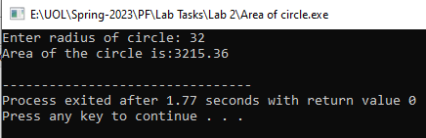
Task - 7
Write a program that will calculates the area of the circle. The area of the circle is πr². The value of π is constant that is 3.14 but radius can change.

Slide 9
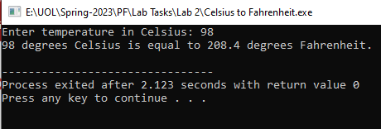
Task - 8
Write a program converts a temperature from Celsius to Fahrenheit. Use the following formula:
F = 1.8 x C + 32.

Slide 10
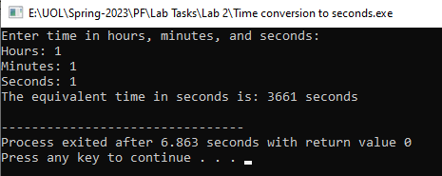
Task - 9
Write a C++ program that reads three integers representing hours, minutes, and seconds of a time. Then it should calculate the equivalent time in seconds.

